Slide 1

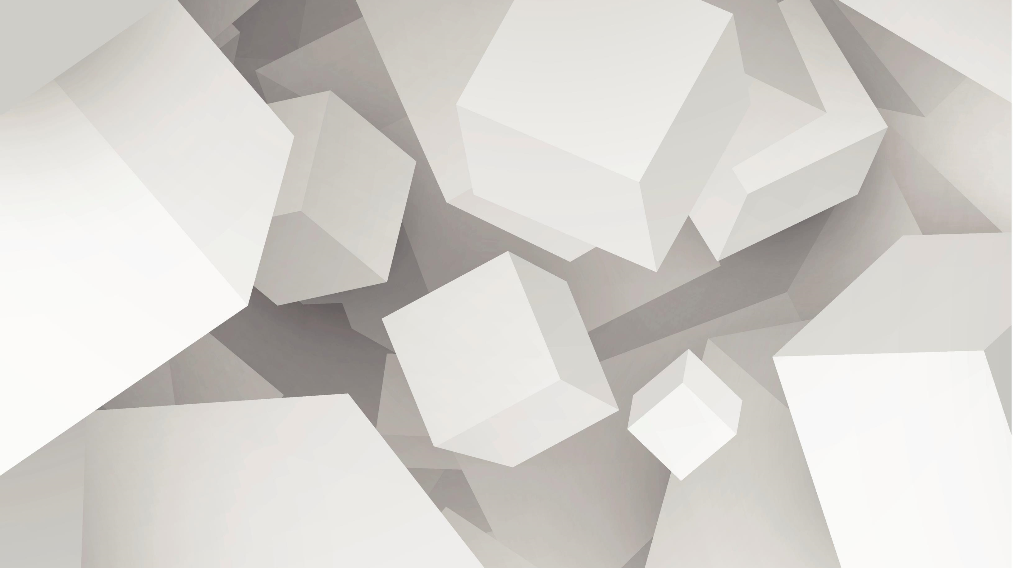
Hardware Ray-Tracing Assisted Hybrid Rendering Pipeline for Games
Kim-Chan Tze Hui, Louiz

Slide 2


Final Presentation
Introduction
Related Works
System Design
Implementation
Analysis
Future Work

Slide 3
Introduction
Create a novel distributed real-time hybrid rendering algorithm
Render a 3D scene in real-time
Split the rendering workload over multiple devices
Allow less powerful hardware to achieve higher quality rendering
Combines raytracing and rasterization
Notes:
The project’s goal was to create a novel distributed real-time rendering algorithm that combines raytracing and rasterization in creating the final output. So there’s a few main concepts to introduce. We wish to make a rendering pipeline that can render a scene in real-time<>, so the framerate must be high enough to make the graphics rendering program interactive. The second is that we wanted to make a distributed algorithm, which means we split the rendering workload over multiple devices<>. The main reason for this is to allow less powerful hardware to achieve high quality renders<> that they normally would not be able to achieve, but can do so with assistance of another device with better hardware. Finally, we want to use a hybrid rendering algorithm that combines raytracing and rasterization<>. So first I’ll explain the difference between these two rendering algorithms.

Slide 4
Introduction – Rasterization and Ray-tracing
Rasterization – the traditional graphics method
Works on basically all graphics cards
Compute screen space locations of triangles and draws them to screen
World Space (in data)
Screen Image
Notes:
First I’ll quickly explain rasterization. This is the traditional<> graphics rendering method that is available on all devices <> that have graphics cards. The way it works is that we have a 3d scene representation in data form<>, which is just the coordinates of triangle corners and how they are joined. For each triangle in the scene, we draw it to screen by computing where in the screen from the camera’s perspective this should be drawn. So for example, the first triangle may be computed to appear here<>, and the second one here<>. Since the second triangle is in front of the previous triangle, it simply overwrites those pixels that were previously drawn in the final image buffer. The last triangle is drawn here<>, but is behind the triangle that is already drawn, and does not overwrite those pixels. So that’s how rasterization works, we compute the screen space locations of each of the triangles and fill them up on the screen<>, and we do this for all triangles in the scene.

Slide 5
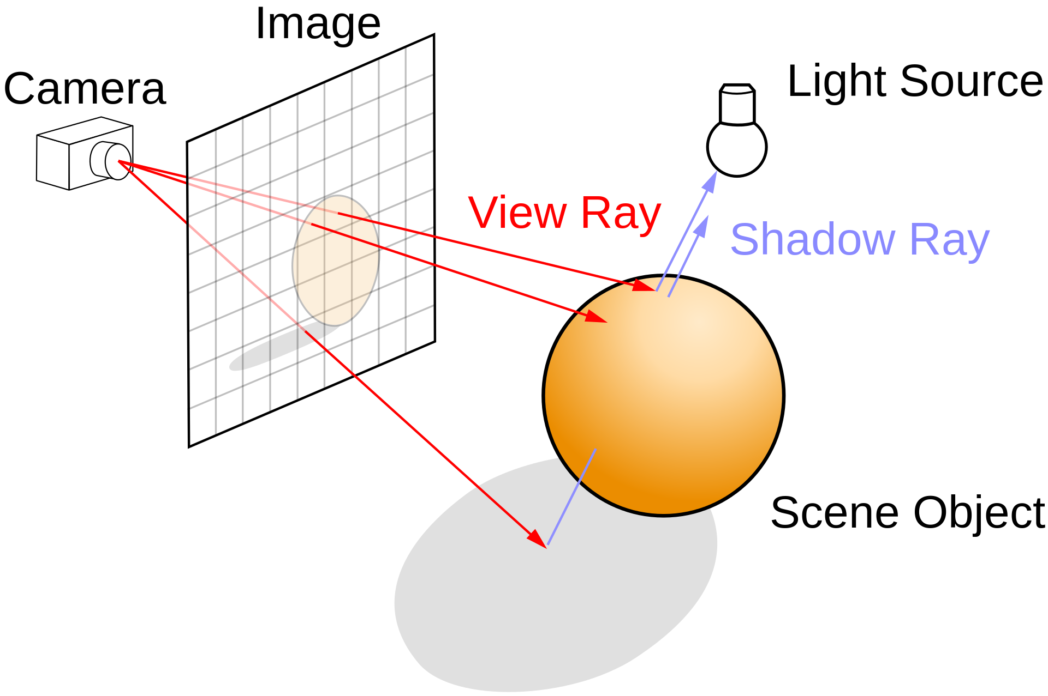
Introduction – Rasterization and Ray-tracing
Often reserved for offline use
Computationally expensive
Ray-tracing involves casting rays and computing closest surface intersections
Image credit: Henrik, source
Notes:
Raytracing on the other hand is a method that is usually reserved for offline use <>, i.e. not real-time, for example in films. This is because it has a computationally expensive step<>, which is to cast a ray into the scene and computing the closest surface intersected<>. So here’s a picture<> that illustrates this. Instead of doing calculations for each triangle in the scene, we perform ray intersections for each pixel in the scene, and check what the closest surface it collides with is. And again, each ray-scene intersection computation is computationally expensive, so you require high end hardware to perform this in real-time.

Slide 6
Introduction – Rasterization and Ray-tracing
Raytracing is more photorealistic
Requires a 10-100s of ray computations for usable frames
Instead, use few rays per pixel and denoising filters
Can use a hybrid of raytracing and rasterization to cut down on raytracing cost
Notes:
But even though it’s more expensive, the main reason to use raytracing techniques is that they can achieve more photorealistic graphics<> than traditional rasterization can, but performing pure ray-tracing to obtain usable images requires dozens to hundreds of rays<>, which is too expensive, so what is usually done is that a few rays per pixel are used, in combination with denoising filters<>. Additionally, commercial engines also use a combination<> of raytracing and rasterization to cut down on the cost of raytracing as much as possible.
So for this project, we were looking into whether we could perform hybrid rendering, but distributing it across two devices.

Slide 7
Introduction – Distributed Rendering
Higher quality achievable from raytracing
Distributing rendering to cloud resources means lower-end hardware can still achieve higher quality
E.g. Mobile devices
5G and edge computing
Notes:
Again, the main reason to do this is to achieve higher quality renders using raytracing<>, but on hardware that is not able to support it by using cloud resources<>. The eventual target would be mobile devices<>, which typically do not have graphics cards that can support ray-tracing. What will make this more feasible in the near future is the rise of 5G and edge computing<>, which will make latency to such cloud rendering services much lower, so that this becomes more feasible.
Now before we go to our solution, we will look at some other approaches in cloud based rendering.

Slide 8
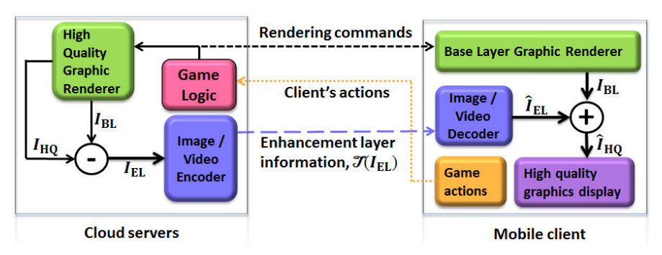
Related Works
Cloud based gaming
E.g. Google stadia, GeForce Now, Playstation Now etc.
Game runs on server, streamed to client (direct coding)
Noticeable latency
Partially rendering on the client
Server only needs to send deltas, rather than full frames
Seong and Ngai (2014) – Layered Coding
Improved compression via H.264 compared to direct coding
Seong and Ngai (2014) – Layered Coding
Notes:
We need to make several distinctions, so first we look at cloud based gaming<>, which is available in services such as google stadia,<> geforce now, play station now etc.. These work by letting the user’s input be sent to the server, but the entire game runs on the server, and the client sees a video feed of the game<>, which we will call direct coding. Something to note is that these typically these do have noticeable latency<>.
One method to reduce the amount of data that needs to be sent to the client is to partially render the game on the client.<> This way, the server doesn’t need to send full frames over the network, but it can send some deltas<>. As for what these deltas are, one work by Seong and Ngai<> called layered coding had the following architecture. The server is running the game logic, and sends some low quality 3d models to the client. Both will render a base layer, which is a low quality render, but the server also renders a high quality version, the server then sends the client the delta between the high and low quality render, and the client can generate the high quality images. What they found is that sending these deltas achieves a higher compression rate using H.264<> compared to sending the rendered frames directly.
This approach has the game running on the server, but there’s another approach to have the game running on the client.

Slide 9
Related Works
Game runs on the client and server
Eduardo et al (2015)
Three instances running in sync – low quality on client, low quality on server, high quality on server
Send deltas from server to client
Inputs are sent to server to maintain sync
We do something similar, but send raytracing data
Notes:
In the work by Eduardo and others<>, they have three copies of the game running<>, a low quality one on the server and client, as well as a high quality one on the server. Similar to the previously mentioned work, they send the delta from the server to client <> and the client can get a high quality render, and inputs are sent from the client to the server to maintain synchronization<>.
The approach we want to take is a bit opposite from the first work we mentioned and closer to this. In the first work, the game is run on the server with rendering on both, and in the second, the game is run on both, with rendering on both, but what we want is a pipeline that can be used to generally offload graphics rendering to a server.
So our proposed architecture is similar to the second, but instead of sending deltas from a high quality similarly rendered scene, we want to see if we can send some raytracing information <>, so that the client can obtain an image that should only be attainable with hardware that has raytracing support.
Now we will look at our proposed architecture’s, system design. [6:45]

Slide 10
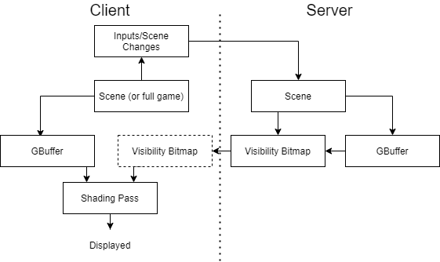
System Design
Basic Direct-Lighting Shading High level architecture
Raytraced
Rasterized
Post-processing
Notes:
Just to make a disclaimer, this is a very simple shading algorithm implementation for now, where we only perform direct-lighting. I will go into detail of a more complete rendering architecture proposal later, but my project only managed to complete up to a rather basic level.
This is the high level architecture that we used for our implementation so far. In our architecture there are two copies of the scene, one on the server and one on the client. Similar to the related work we discussed just now, inputs are sent to the server to maintain synchronization across the two scenes. The difference is that instead of doing a complete high quality render on the server and a complete low quality render on both, we only perform parts of a rendering pipeline on each of the client and the server.
So from this diagram, we can see that both the client and server render their own copy of a rasterized<> Gbuffer, which I will explain later on. The server performs raytracing<> to generate a visibility bitmap, which again, i’ll explain later, and it sends this to the client. The client can then perform a post-processing<> pass where it takes the information from the rasterized and raytraced passes and creates the final displayed frame.
Now that we understand the high level architecture, which is that both the client and server perform a rasterization pass, the server does a raytracing pass and sends the data to the client, and the client performs its final post-processing pass to generate the frame, we will look at the direct-lighting shading algorithm in detail.

Slide 11
System Design – Algorithm
Rasterize the scene to create a GBuffer
For each pixel in the GBuffer
Initialize the color c to (0, 0, 0)
For each light, l, in the room
Trace a ray from the pixel’s world position, wPos, to the light’s world position
If the ray is not obstructed by any object
Get the (world space) normal vector of this pixel, n, and the diffuse color, m
c ← c + Lambertian(n, m, wPos, l)
Set the pixel color to c
Notes:
This is the algorithm we’re using as a whole to perform our direct lighting algorithm. I’ll go through step by step what we do.

Slide 12
System Design – Algorithm
Rasterize the scene to create a GBuffer
For each pixel in the GBuffer
Initialize the color c to (0, 0, 0)
For each light, l, in the room
Trace a ray from the pixel’s world position, wPos, to the light’s world position
If the ray is not obstructed by any object
Get the (world space) normal vector of this pixel, n, and the diffuse color, m
c ← c + Lambertian(n, m, wPos, l)
Set the pixel color to c
Notes:
First we rasterize the scene to create a Gbuffer.

Slide 13
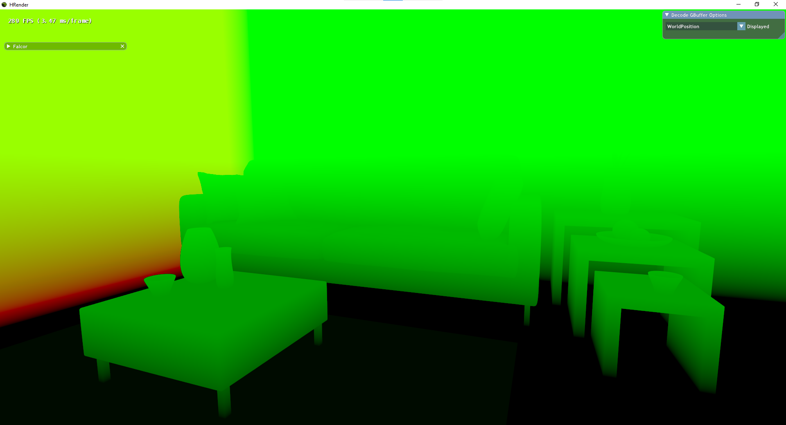
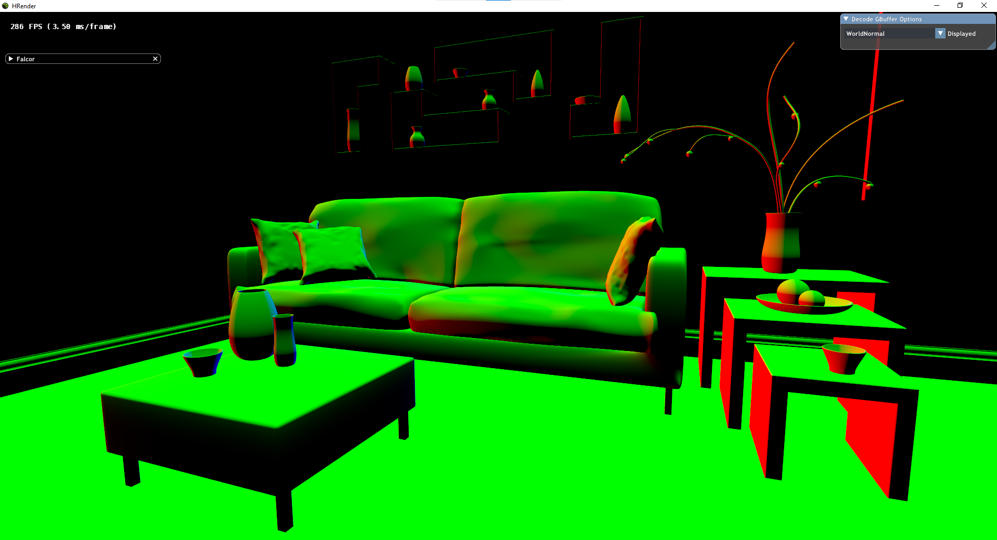
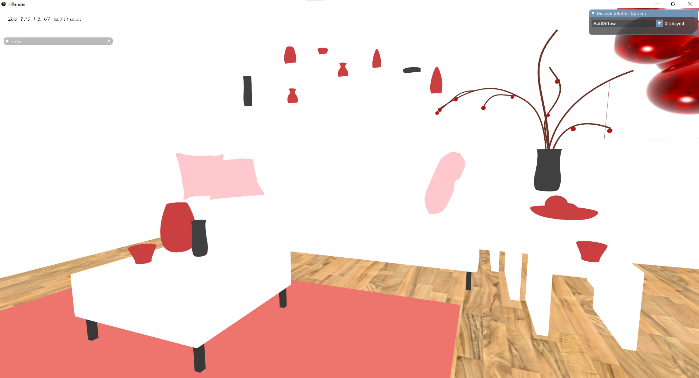
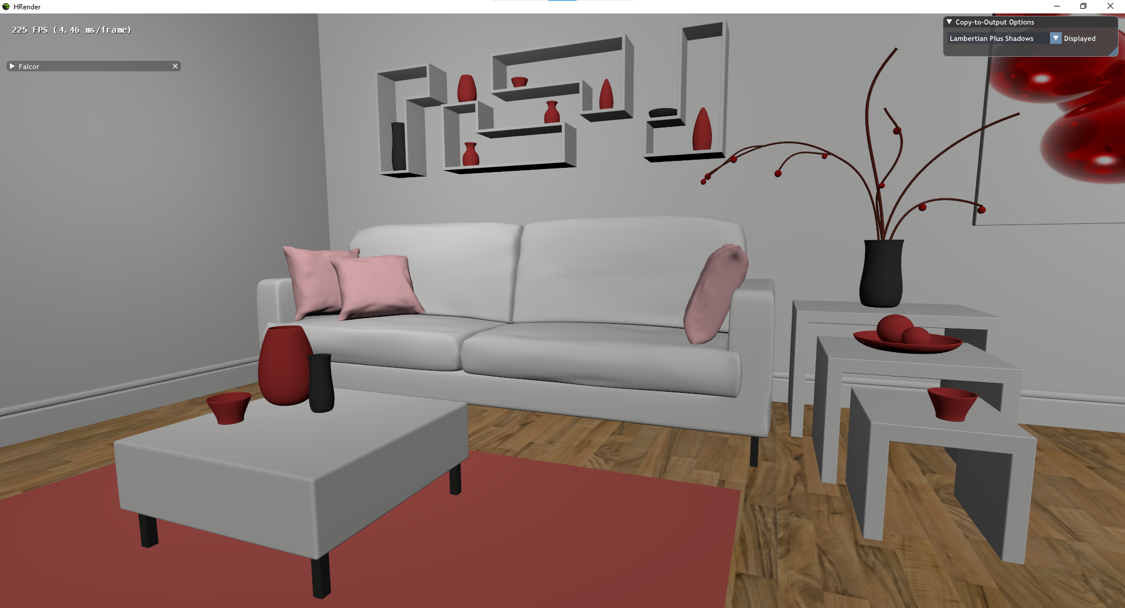
Screen Image
World Space (in data)
Screen Image
Texture Outputs
Positions
Normals
Colors
Shaded output (no shadows)
Notes:
Again, rasterization means that we take all the primitive scene data, and render them to the screen, and whatever is closest to the camera will overwrite any previously drawn triangles.
However, when we want to rasterize a Gbuffer, we aren’t rasterizing the final image. So instead of rasterizing to a screen image, we rasterize to a texture<>, which is just a bitmap stored on the GPU memory. Additionally, we don’t perform shading here, instead we want to produce the necessary geometry information to be later used by other passes to be able to make the final shaded image. So what we render is the position coordinates in world space of the pixels<>, the normal<>, and the material color<>. These, along with the lights information, are sufficient to create a shaded output image by post-processing on these textures<>, although this does not have shadows. For shadows, we need additional information. Traditionally, we can use shadow mapping, but we will discuss a raytraced solution which has the potential to generate more realistic shadow
.So that is the first step.

Slide 14
System Design – Algorithm
Rasterize the scene to create a GBuffer
For each pixel in the GBuffer
Initialize the color c to (0, 0, 0)
For each light, l, in the room
Trace a ray from the pixel’s world position, wPos, to the light’s world position
If the ray is not obstructed by any object
Get the (world space) normal vector of this pixel, n, and the diffuse color, m
c ← c + Lambertian(n, m, wPos, l)
Set the pixel color to c
Notes:
Where we produce the Gbuffer.
Next, we need to perform shading for each pixel.<>

Slide 15
System Design – Algorithm
Rasterize the scene to create a GBuffer
For each pixel in the GBuffer
Initialize the color c to (0, 0, 0)
For each light, l, in the room
Trace a ray from the pixel’s world position, wPos, to the light’s world position
If the ray is not obstructed by any object
Get the (world space) normal vector of this pixel, n, and the diffuse color, m
c ← c + Lambertian(n, m, wPos, l)
Set the pixel color to c
Notes:
The way we do this is that we have our pixel’s starting color as black, and for each light in the room, we will add its contribution to the pixel. This will give us the final color. But as mentioned just now, this will lead to a <> image without shadows. So the way we can add shadows is with this raytracing step.<>

Slide 16
System Design – Algorithm
Rasterize the scene to create a GBuffer
For each pixel in the GBuffer
Initialize the color c to (0, 0, 0)
For each light, l, in the room
Trace a ray from the pixel’s world position, wPos, to the light’s world position
If the ray is not obstructed by any object
Get the (world space) normal vector of this pixel, n, and the diffuse color, m
c ← c + Lambertian(n, m, wPos, l)
Set the pixel color to c
Notes:
Now, instead of adding the light’s contribution unconditionally, we perform raytracing to make sure that the light can reach that point. So what does that look like in practice?

Slide 17
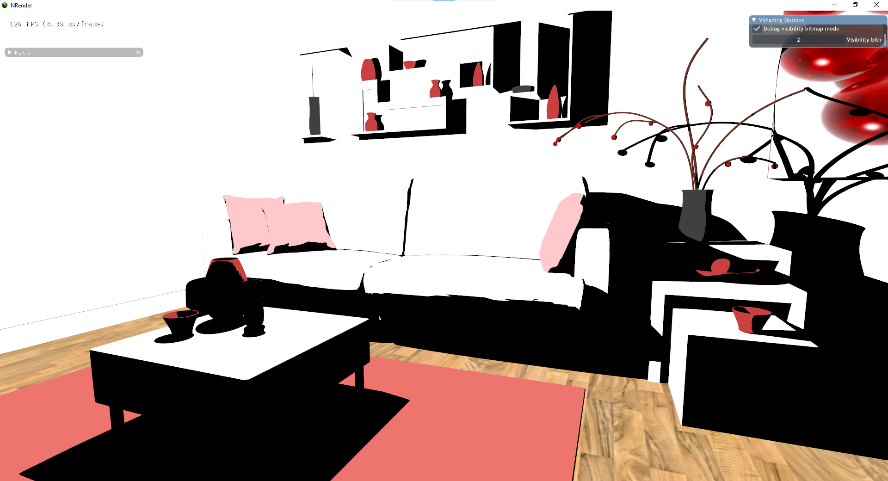
Notes:
Let’s say we have a scene that looks like this. We have a light over here<>. It’s in 2d so you’ll just have to imagine a bit. Now let’s say we wanted to shade pixels in this area<>, so what we would do is that for each pixel here, if we want to know whether this light should contribute to the shading at this point, we trace a ray to the light<>. We notice there’s nothing blocking the light, so we can add its contribution.
If we wanted to shade a pixel here<> instead, we trace a ray to the light<>, but it is blocked by some surfaces<>, so these areas will be shadowed and the light will not add its contribution.
So we get a Boolean for each pixel for this light, represented by this final image<>. This isn’t the final image, but it’s just colored if the ray from that pixel to the light is unobstructed, and black otherwise. So this should hopefully give a clear understanding of how each pixel is shaded. We do this for each light<> [10:25]

Slide 18
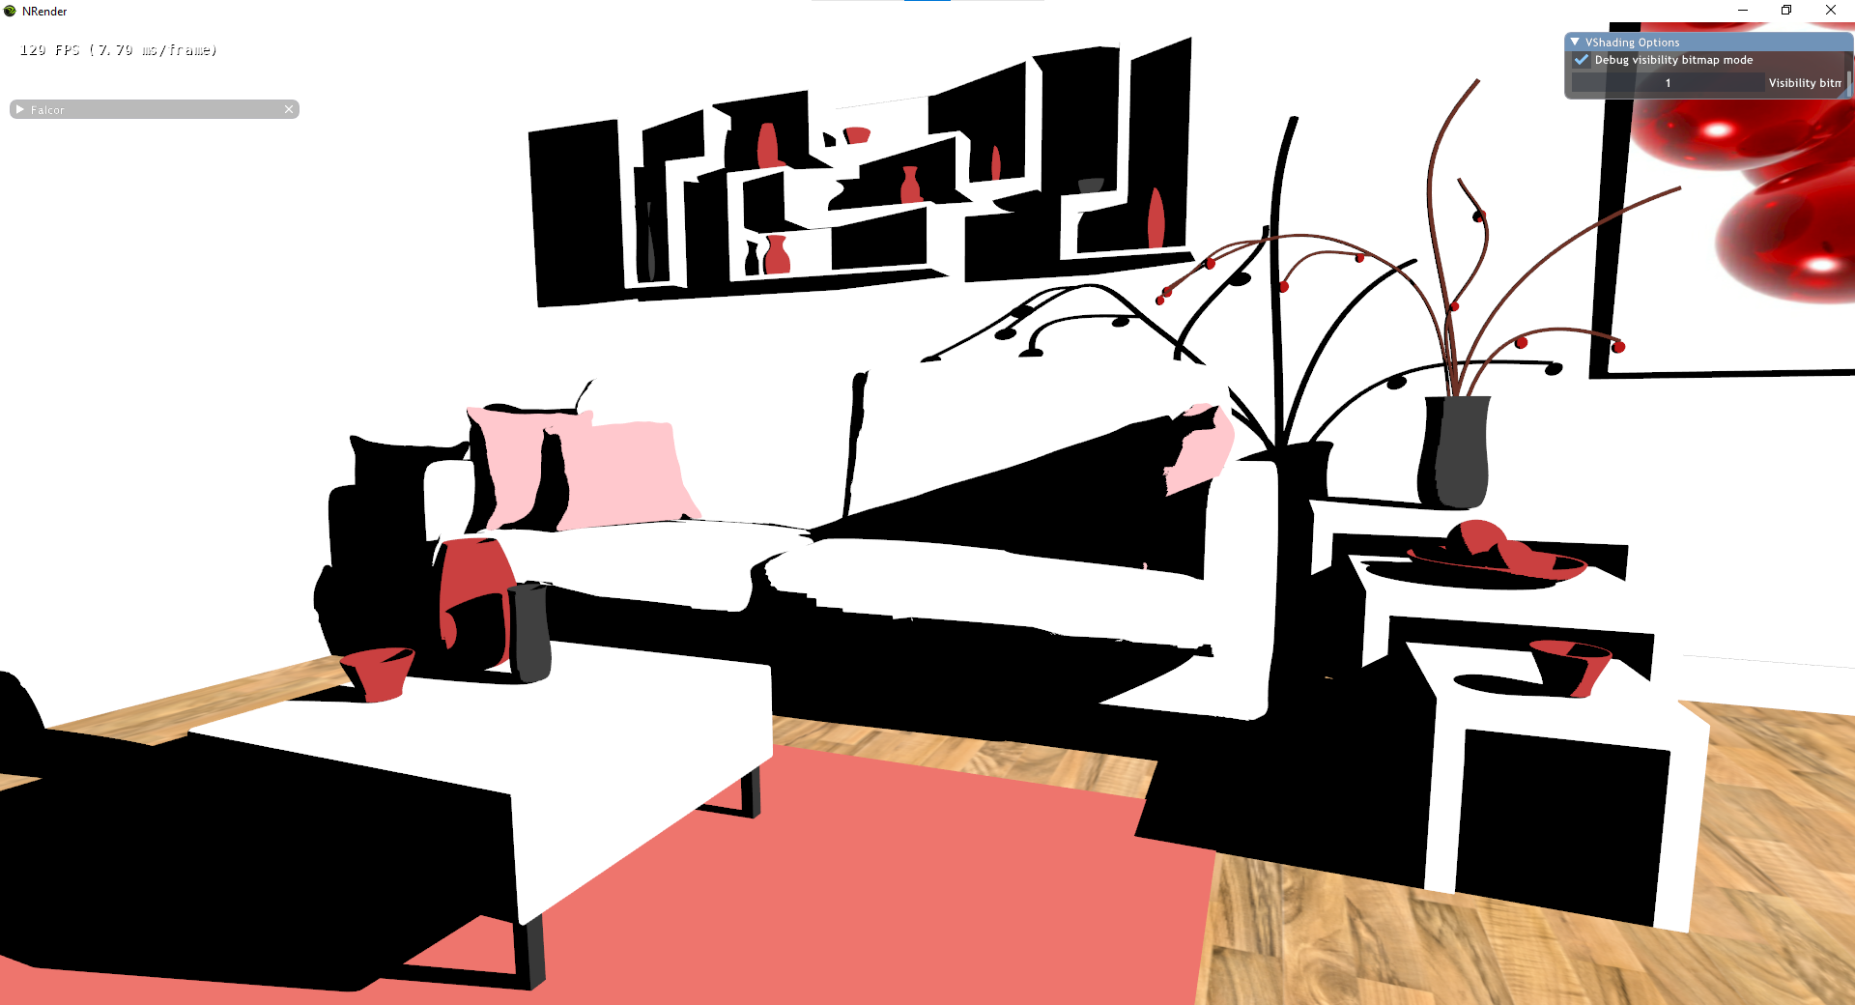
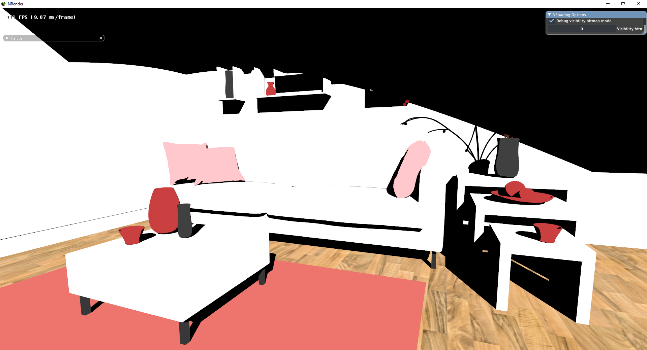
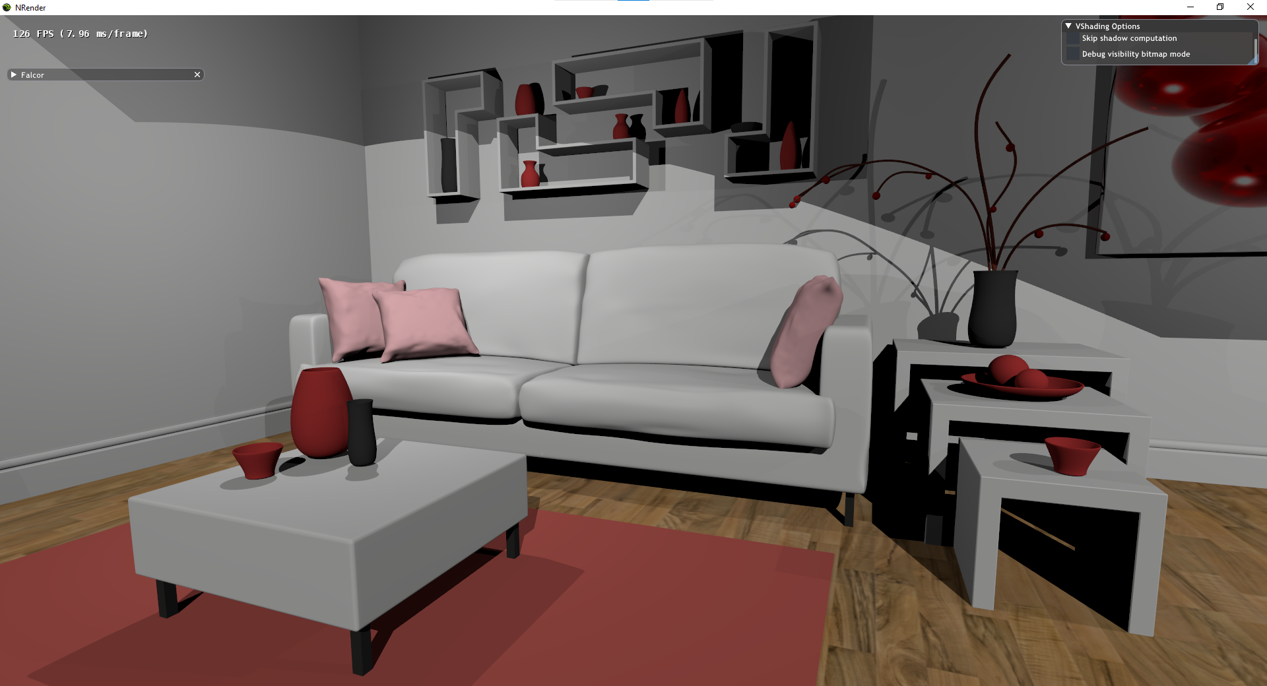
Notes:
And we get the final image.

Slide 19
System Design – Algorithm
Rasterize the scene to create a GBuffer
For each pixel in the GBuffer
Initialize the color c to (0, 0, 0)
For each light, l, in the room
Trace a ray from the pixel’s world position, wPos, to the light’s world position
If the ray is not obstructed by any object
Get the (world space) normal vector of this pixel, n, and the diffuse color, m
c ← c + Lambertian(n, m, wPos, l)
Set the pixel color to c
Notes:
One final detail to note is that we use the Lambertian<> shading equation to shade our surfaces

Slide 20

System Design – Algorithm
Rasterize the scene to create a GBuffer
For each pixel in the GBuffer
Initialize the color c to (0, 0, 0)
For each light, l, in the room
Trace a ray from the pixel’s world position, wPos, to the light’s world position
If the ray is not obstructed by any object
Get the (world space) normal vector of this pixel, n, and the diffuse color, m
c ← c + Lambertian(n, m, wPos, l)
Set the pixel color to c
$$E=\sum_{i}{\frac{I_{i}}{π}∗ρ∗\max\left(dot\left(n, L_{i}\right), 0\right)∗k_{shadow, i}}$$
Notes:
This leaves us with the final pixel color for each pixel based on the raytraced information from each light.
So this is how it would look like if the algorithm was performed serially, but we need to split this into a distributed algorithm.
[4:40 + 6:45 = 11:25]
We observe that the information from raytracing in this algorithm is just a Boolean per light per pixel. As such, the way we distribute the algorithm was as in our architecture we mentioned before.

Slide 21
Visibility Bitmap
Unsigned 32-bit integer per pixel
000……0010110
Notes:
So just for some details on how we implement the visibility bitmap here, each pixel is an unsigned 32 bit integer<>. This is a bitmask, where each bit represents whether light i is unobstructed. So for example, if this is the bitmask<>, and our scene has 5 lights, it means that light 0 is obstructed, light 1 is unobstructed, 2 is unobstructed, 3 is obstructed, and 4 is unobstructed. So this information is sufficient to tell our shading pass whether each light contributes to the shading, and we can generate our shaded scene.
In the future work section I’ll talk about how we can extend this architecture. For the last slide of the system design part, I’ll mention the data flow as well to achieve this architecture.<>

Slide 22
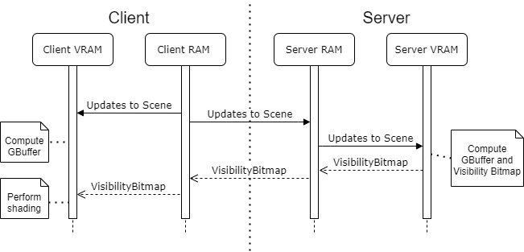
Data Flow
CPU cannot access VRAM data directly to send it via network
Notes:
Even though we’re dealing with two devices, we’re dealing with separate memory on each device. The computer has RAM, but the GPU also has its own dedicated video RAM that is only meant for use by the GPU. We can transfer memory from the RAM to the video RAM and vice versa, but the CPU cannot directly access the VRAM to send its data to the client<>. So we have this sequential memory transfer that needs to take place.
Before the frame starts rendering, the client sends its scene updates to its own GPU memory, and sends the updates to the server as well. The server then updates the scene which modifies the GPU representation of the scene. The GPU then can render the visibility bitmap, and it needs to transfer this from the VRAM to the RAM so that the CPU can then send it over the network to the client. The client will then load it to its VRAM, and then it can be used for the post-processing step.
That should give a high level understanding of the architecture and data flow, so now we’ll look at the implementation details<>.

Slide 23
Implementation Details (Hardware)
Two devices
Connected via Ethernet with home router
RTX-2060
Notes:
First I’ll briefly mention the hardware, we are performing a distributed rendering algorithm, so we have two devices<>, and it’s a prototype for cloud rendering, so they are connected by ethernet for now via a home router<>. Since we are using raytracing in real time for the server, we are using NVIDIA’s Turing hardware, the RTX-2060 in my case<>. As for the software,

Slide 24
Implementation Details (Software)
NVIDIA’s Falcor
DirectX 12, DirectX Raytracing
Handles:
Context creation/management
Window and input handling
Shader program compilation
3d asset management
Tutorial “RenderingPipeline” framework base code
Focus more on the algorithm than low level details
Notes:
We are building on top of NVIDIA’s Falcor framework<>, which is a prototyping framework that builds an abstraction layer on top of DirectX 12 and directX raytracing<>. This handles<> calls to directx so that we have an easier time managing these things.
(e.g. 3D scene file input/output, Construction of DXR acceleration structures, Convenient interface for toggling animation, camera movement, light/material properties
On top of that, we based our rendering pipeline base code on a Falcor tutorial by Chris Wyman from NVIDIA.<> By using this base code, we could focus on the algorithmic side of the rendering and just focusing on writing the logic and shaders, rather than the lower level implementation details<>.
I’ll now explain the implementation architecture.

Slide 25
RenderingPipeline
ResourceManager
User
RenderPass
RenderingPipeline
RenderPass
RenderPass
RenderPass
Falcor
Notes:
This illustrates how the rendering pipeline works. Rendering pipeline is the framework that kind of holds everything together, and makes the rendering happen step by step. It implements an interface and is called by Falcor. Falcor itself handles the main event loop, whereby it handles inputs, updates the scene on the GPU, and renders the scene, and it does this by calling the methods on the RenderingPipeline. So when Falcor needs to handle inputs, it calls RenderingPipeline :: onMouseEvent or onKeyEvent, when it needs to render the GUI it calls the RenderingPipeline’s onGuiRender, and similarly for rendering the scene, it calls onExecute. So how our RenderingPipeline executes these is by calling the RenderPasses in sequence. Each renderpass is an abstraction for taking some inputs, which can be the scene or other textures on the GPU memory, and it has some outputs, which are textures on the GPU memory. RenderingPipeline will call them in sequence that it was initialized with, and this way we can generate our scene, like just now we described that we first create a Gbuffer in one render pass, then a visibility bitmap in another render pass, then a post-process renderpass where we combine the two. That is what the RenderingPipeline does and how it works with the renderpasses.
There is also a resourceManager so that the renderpasses usually do not need to directly interact with Faclor, and it holds on to references to the scene and textures, as well as calls for the creation of these resources. This acts as sort of a global way to access things between passes, so the passes don’t need to talk to each other directly, they can retrieve inputs and outputs from the resource manager.
Next we look at the implementation for our distributed rendering algorithm<>.

Slide 26
Distributed Rendering – RenderPasses
Client
NetworkPass (Send inputs)
GBufferPass
NetworkPass (Receive VisibilityBitmap)
MemoryTransferPass (CPU to GPU)
ShadingPass
OutputPass
Server
NetworkPass (Receive inputs)
GBufferPass
VisibilityPass
MemoryTransferPass (GPU to CPU)
NetworkPass (Send VisibilityBitmap)
Concurrent with rendering passes:
“Network Thread”
Notes:
Here are the render passes for our algorithm. Since this is distributed over two devices, there are two rendering pipelines which we saw in the previous slide that need to execute concurrently, one on the server and one on the client. The difference is which render passes are run on them.
On the client, we have a network pass to send the inputs to the server, the client then performs a gbuffer pass, then it has a network pass to receive the visibility bitmap from the server, and then it has to transfer the received texture from the CPU to GPU memory, it then performs its shading pass.
On the server, it first has a network pass to receive inputs from the client, then it performs its own gbuffer pass, it then performs its raytraced visibility pass, then it needs to perform a memory transfer pass to get the texture from the gpu to the cpu memory, then it sends it to the client in a network pass.
It’s not illustrated in this high level architecture, but for our implementation, we have a network thread that is constantly listening over the network, rather than sequentially. In the future, this might help with extensibility. The sequence of events is as follows.

Slide 27
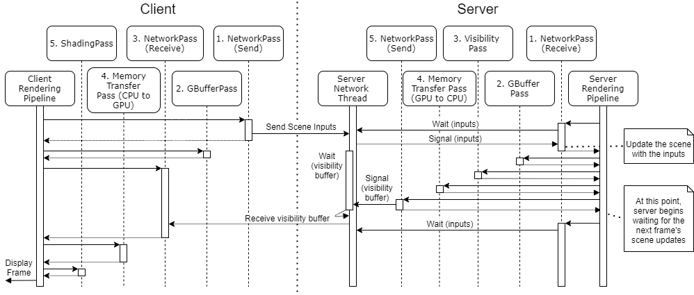
Notes:
This is what happens in a single frame. There’s quite a lot of things going on here, so I’ll highlight a few parts.
As mentioned before, there’s a network thread on the server that’s always listening. The render passes on the server are all running on a single thread as well, so there’s a need to synchronize the two threads.
First on the client side, this is a single threaded operation so it’s straightforward, the rendering pipeline will call the passes in order, first sending the inputs, then rendering the gbuffer, then it will receive the visibility buffer on the network, so this is blocking and it will wait until the visibility buffer is received, then it will transfer this to the GPU, then perform the shading pass where it performs post processing on the gbuffer and visibility buffer, and finally it can display the frame.
On the server side, the first network pass happens to wait for the scene inputs. So note that our actual network receiving is done on this server thread, so what the network pass does is that it actually just waits for the server thread to receive the inputs. The waiting is done on a conditional variable, which is similar to a semaphore. It simply waits until the network thread signals that semaphore, and then it lets the pass continue. After receiving the inputs, it updates the scene with the inputs, and then the server performs its gbuffer pass and raytraced visibility pass. Then it has a pass to transfer the rendered visibility bitmap from the gpu to cpu memory, then it has a network pass to send it to the client. During this time, the network thread actually has been waiting on a conditional variable as well, so once the networkpass is reached, the network thread is notified and it can send the visibility bitmap to the client. This is the completion of one frame on the server, and it begins waiting for the next received scene inputs.
[8:00 + 11:25 = 19:25]

Slide 28
Demonstration
Notes:
Now I’ll demonstrate the program in action.

Slide 29

Notes:
So there are two screens in this video that you can see, the left is the server’s screen which is on a separate device, and the right is the rendered output of the client device.
So over here in the server we can see that there are three different lights, that’s why there were a few different visibility bitmaps, and on the right is the combined output from postprocessing the Gbuffer and the visibility bitmap from the server. As you can see, the client device is free to move the camera around, because these inputs are sent to the server and the scenes are synchronized. So I’m just moving around and showing the different visibility signatures of different parts of the room.
This is another scene, where there are two lights. So this is the visibility bitmap of the other light, we can see the difference, and this leads to double shadows. It’s not so obvious from the video unfortunately.
So that was how the program looks like in action. [19:00]
Now we come to the analysis, we’ll take a look at the visual quality produced<>.

Slide 30
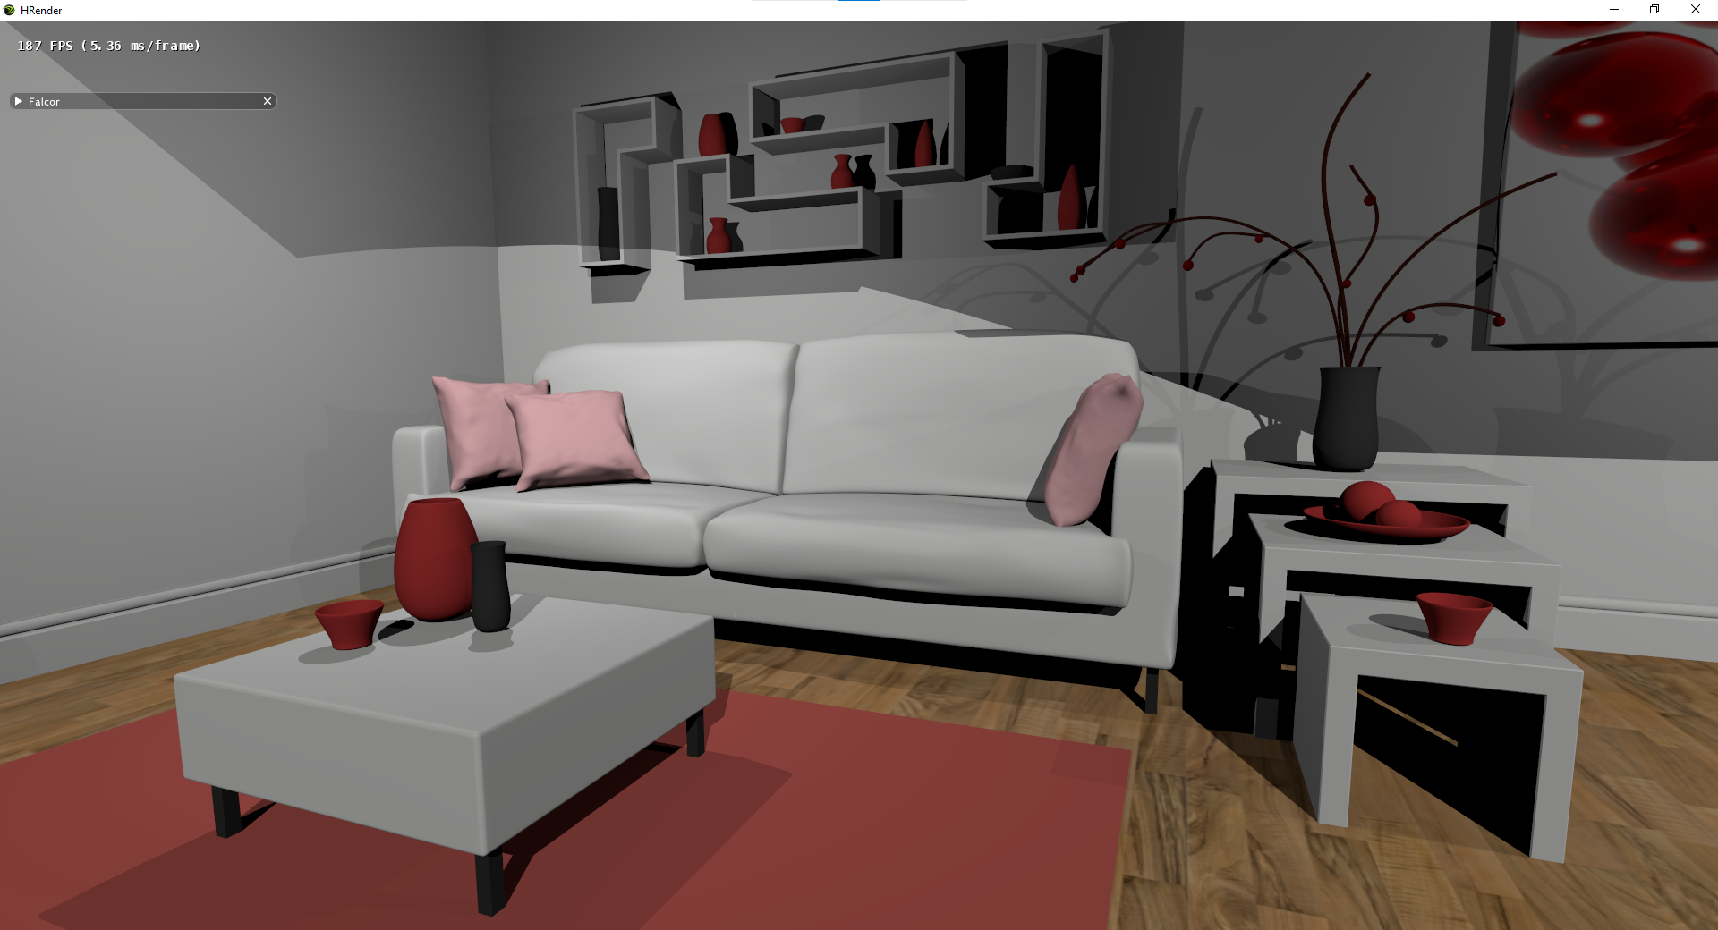
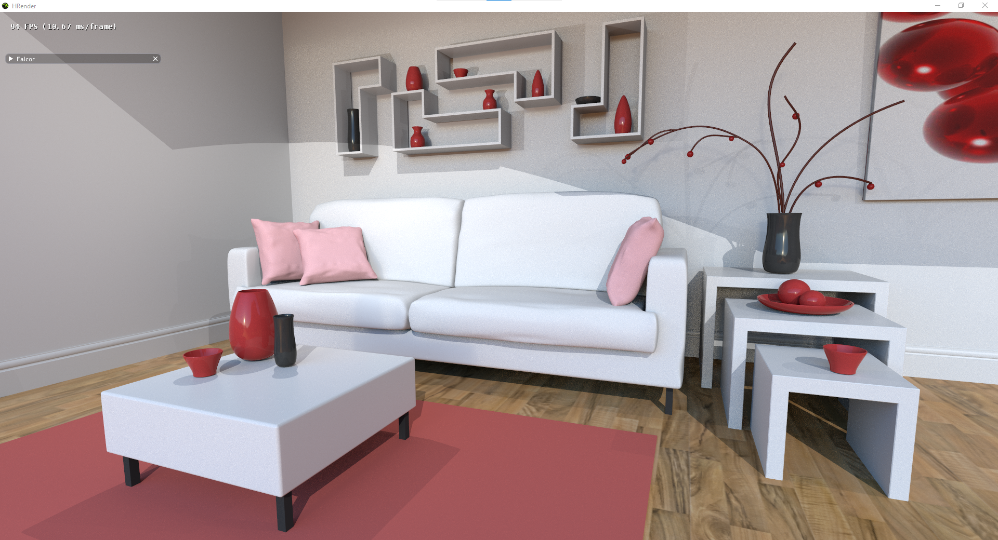
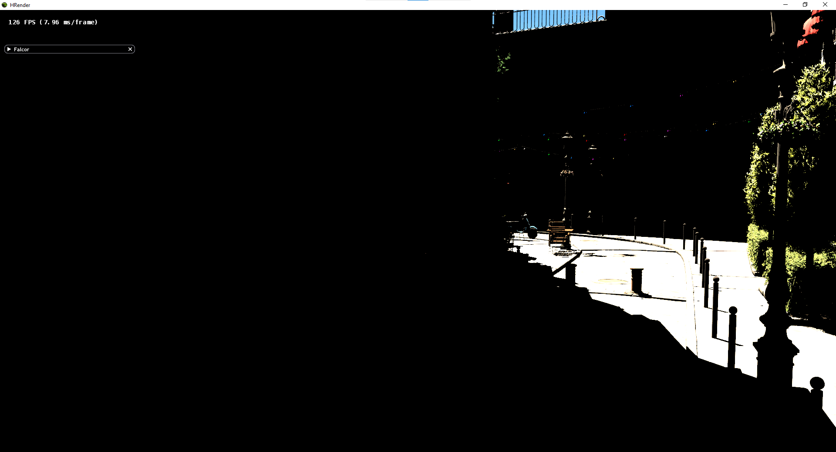
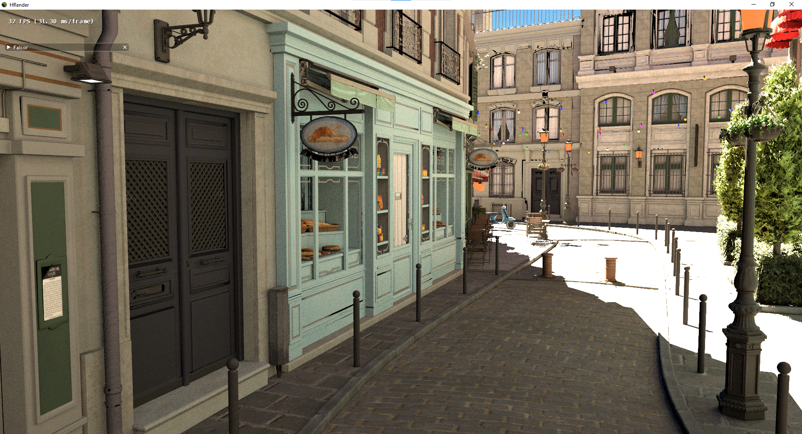
Analysis – Visual Quality
Only supports direct lighting
Direct Lighting
One bounce Global Illumination
Notes:
So right now, the rendering algorithm we are using is still rather primitive, as it is purely a direct-lighting based one<>. So in a realistic scene we would normally have light bouncing around the room, but in this, light only can come directly from light sources.
So for example in this scene we saw<>, on the left image which is produced by just direct lighting, the shadowed area under the table is completely black. In real life however, the light would bounce around and it would still be lit, just darker. On the right we have a simple global illumination algorithm where light from one bounce away will contribute to the light at a pixel, and we can see the difference.
This is even more stark in this bottom scene<>, where there is only one light source, so the shadowed area is completely dark, which makes this scene unusable.

Slide 31
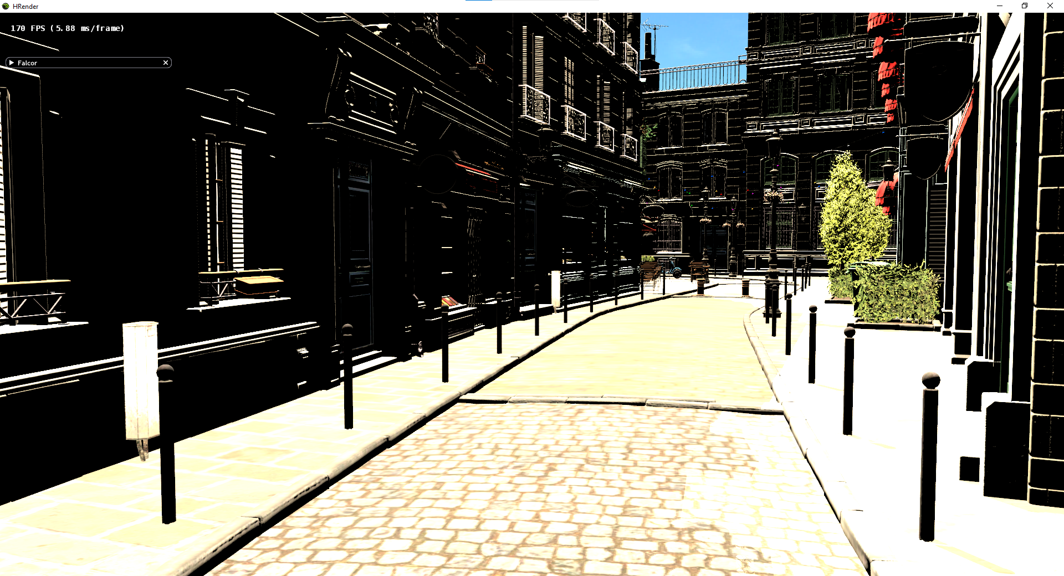
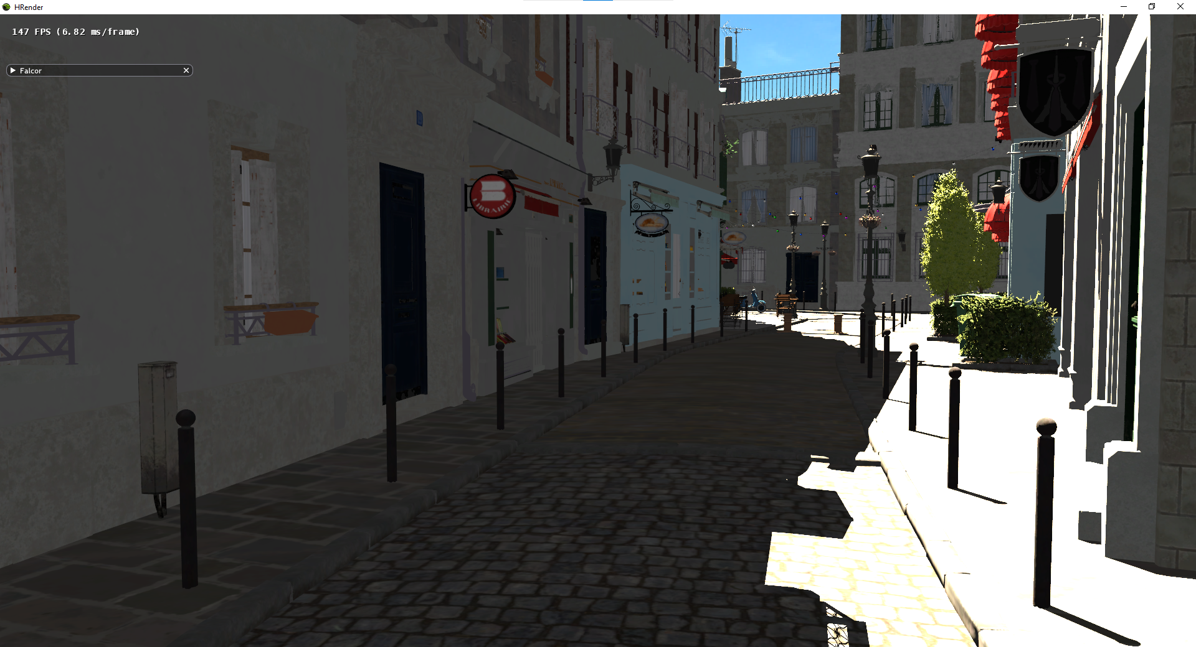
Notes:
There are some hacks we can use to help overcome this. The bottom left is what we have originally, bottom right is the global illumination result. In the upper left we make lights contribute even if they are obstructed, but this doesn’t help for surfaces facing away from the light. In the upper right, we add an ambient light so that even if an area is shadowed, an imaginary light still lights it, but the color is flat and it doesn’t really look very good.

Slide 32
Analysis – Visual Quality
Add support for global illumination
Offline global illumination baking
Trace ray of one bounce for each pixel
Requires denoiser
Notes:
So to actually overcome this, we need to add support for global illumination<>, as well as modifying the equations used for lighting. One commonly used method is baking<>, where we perform the lighting computations via raytracing offline and bake them into the textures, so that we don’t actually need to perform raytracing in realtime. But this is not fully generalizable, for example it doesn’t allow the lighting to change when we add new actors or move the objects around.
A method more in the spirit of real time rendering would be to add the contribution of light from a bounce away<>. To do this, instead of just casting rays toward the lights<> in the scene, we also shoot a random ray into the scene<>, and contribute that surface’s color to the shaded point as well. We can recursively count multiple bounces as well<>, or multiple rays per pixel per frame.
This also requires the use of a denoiser<>.
So doing this requires an extended architecture.

Slide 33
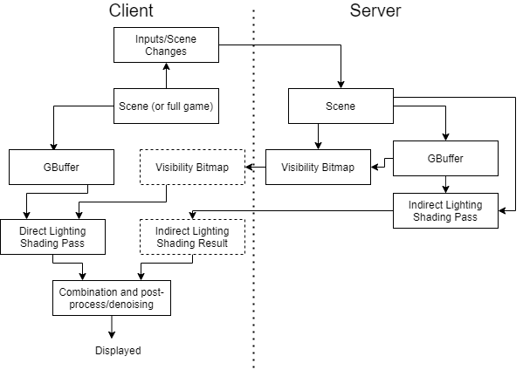
Extended Architecture
Additional indirect lighting shading pass
Requires denoising
Notes:
So the main addition would be the addition of an indirect lighting shading pass<>, where we compute contributions from light bounces, and we will send this to the client in addition to the direct lighting result. We can combine the direct lighting result with the global lighting result, and we also need a denoiser<>.
Next we look at the analysis of the frame rate.

Slide 34
Analysis – Framerate
Pass | Time (ms) | %
GBuffer (Server) | 15.38 | 11.86
Visibility Pass (Server) | 8.18 | 6.31
Memory Transfer (Server GPU to CPU) | 13.24 | 10.21
Network Pass (Server) (both send/receive times are included) | 87.33 | 67.36
Memory Transfer (Client CPU to GPU) | 4.14 | 3.19
Visibility Shading Pass (Client) | 1.14 | 0.88
Output Pass | 0.24 | 0.19
7-8fps
Lower than desired 30fps
Visibility bitmap is 8.3MB
Should use H.264 compression
Currently using TCP
Should implement UDP
Notes:
So the framerate of our program is roughly 7 to 8 frames per second<>, and this is much lower than the desired 30fps<>. From the video demonstration, you can see that the program is still interactive, but it’s choppy and not good enough for games. From the table on the right, we can see that what takes up the bulk of the time is the network pass. The visibility bitmap itself is around 8.3MB<>, which is very big even sending over our single hop router. So what we really need to implement is compression, which we should attempt to use what was used in the literature, H.264 advanced video coding<> that’s used in MP4. This would mean we don’t need to send a full texture each frame, and the encoding is based on changes from the previous frame.
Also, we are currently using TCP<>, so that we would not need to implement error checking. In the later versions, we should move over to use UDP<>, which should speed it up because of lower overhead.. I have tried a basic prototype with UDP, but I require sending very small packets, and after a few seconds I will eventually drop information, and our current setup is not robust enough to handle this yet.
Finally, we look at our proposed future work.

Slide 35
Future Work
Global illumination
H.264 compression
UDP with error checking
Resizable window
Animated scenes (fixed or simulated)
Sending of the scene
Testing on mobile
Notes:
As mentioned in our analyses, we should implement global illumination<> to improve visual quality, compression<> to improve the framerate, and UDP<> to reduce the network overhead. Those are the most important areas to explore to be able to compare this method to currently available methods.
In addition, there are still some features our implementation lacks, like the ability to resize the window, right now it is fixed after starting. We also need to be able to work with animated scenes<>, whether in terms of fixed animations or simulated scenes like in games, as right now only our camera is movable.
We also need to support sending of scenes<>, as currently, the scene needs to be loaded on the server before we can run the program.
Finally, we should also look into testing this with mobile<>, which is the eventual goal.
In conclusion,

Slide 36
Conclusion
Distributed Hybrid Rendering Pipeline
Combines raytracing and rasterization from different devices
Currently still early stage, many areas for improvement
Direction to work on is clear
Notes:
I have worked on a distributed hybrid rendering pipeline <> that combines raytracing and rasterization<> from different devices. Currently, it is still at quite an early stage and has many areas of improvement<>, but the direction to work on in the future is clear<>.
With that, I’ve come to the end of my presentation.

Slide 37
Questions and Answers

Slide 38
Thank you!

